Slide 1


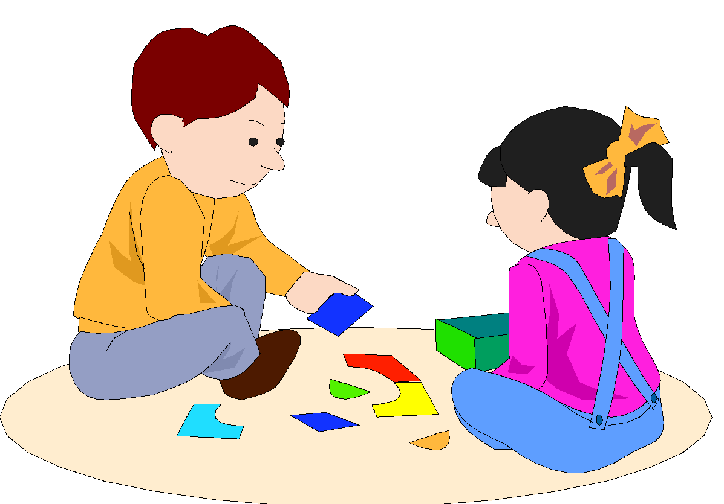
I Can Use My Words
Can I have
a turn?
You took my piece.
I don’t like that!
Created by Rochelle Lentini, USF
Adapted 2004

Slide 2


Sometimes I forget to use my words.

Slide 3
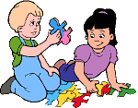



I can use words with pictures,
with written words,
or by talking.
My turn.
I need help.

Slide 4
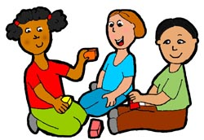
Can I play with you?
When I use words with people, they can understand what I am saying.

Slide 5
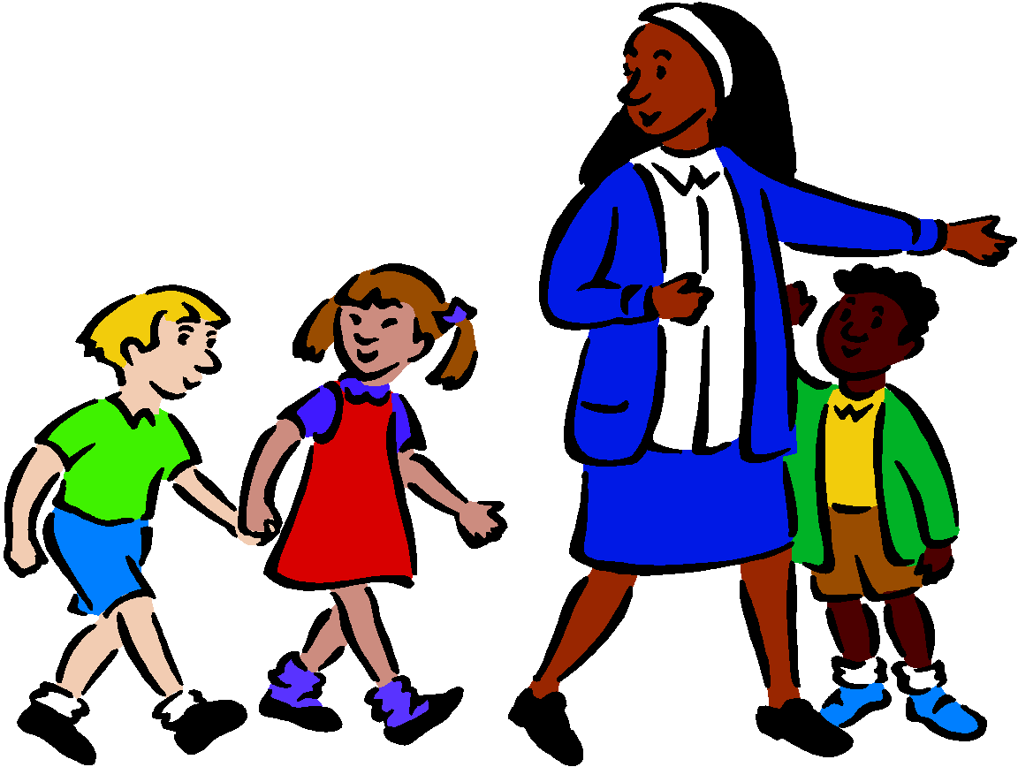

Sometimes I want something I can’t have, but it may be a choice later.
I can use my words and ask, “When can I use this?”
When can I
use this?
After lunch when we
come back outside.
Can I have
a turn?

Slide 6

Everyone is happy when I use my words.

Slide 7
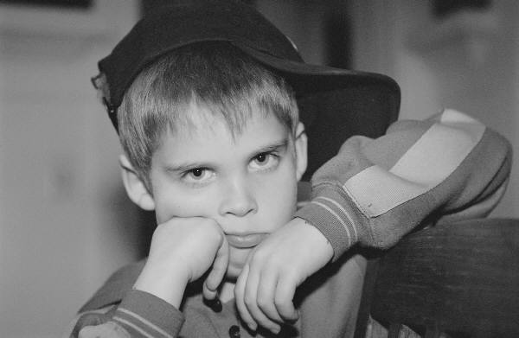
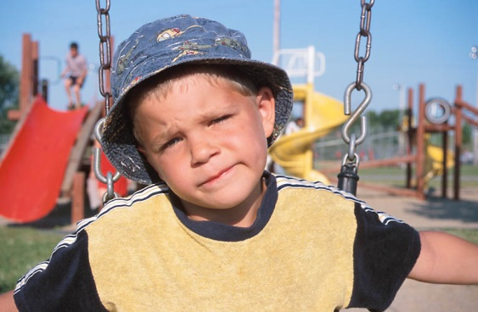
I can use words to tell people how I feel.
I say, “I am mad.”
or
“I don’t like that.”
I’m mad!
I don’t like that!

Slide 8
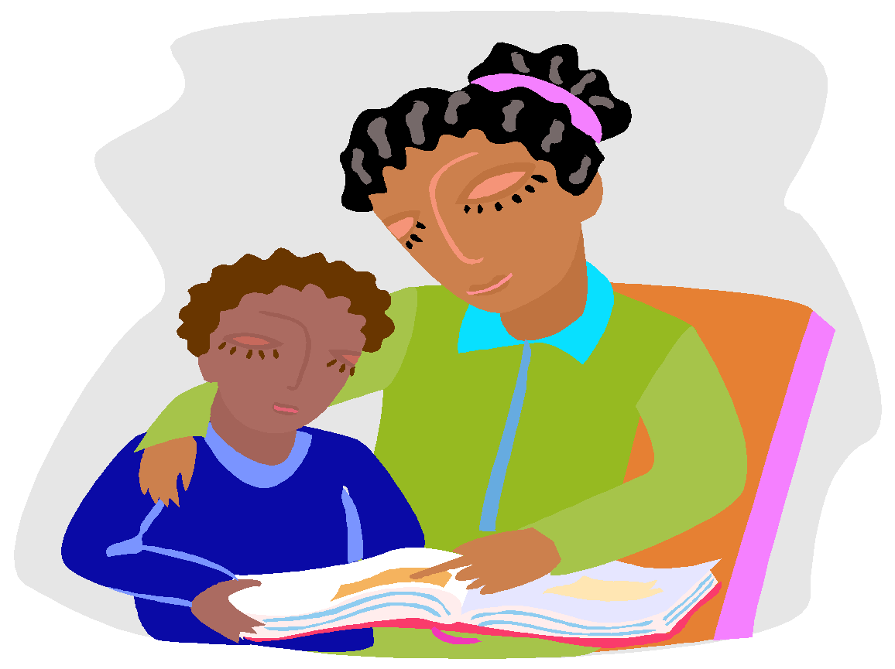
Say,
“I need help.”
Say,
“All done.”
My family and my teachers can help me remember to use words.

Slide 9
Help me please.
Help me please.
I can use words to ask for help.
I can say, “Help me please.”

Slide 10
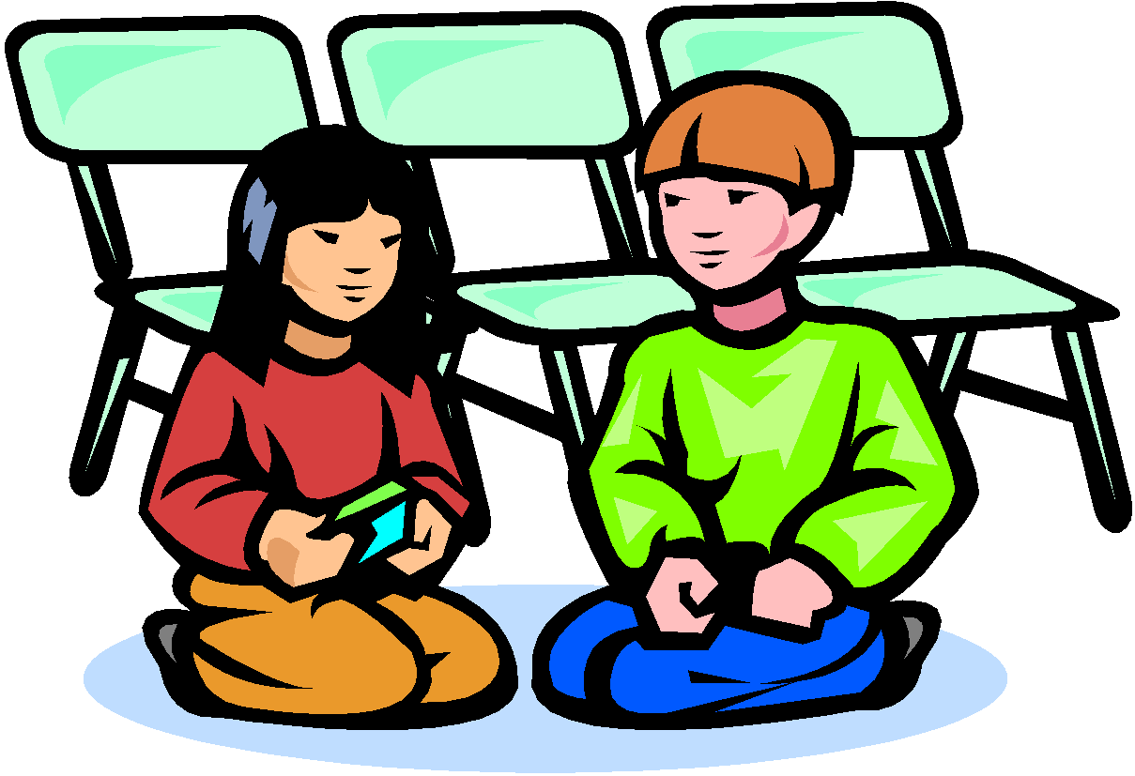

You took my piece.
I don’t like that!
Can I play?
Can I see too?
People can understand me better if I use words.

Slide 11
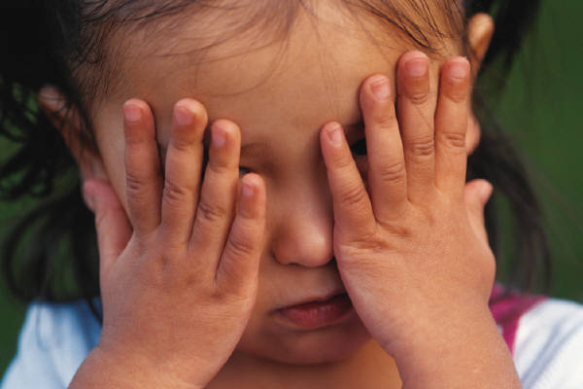

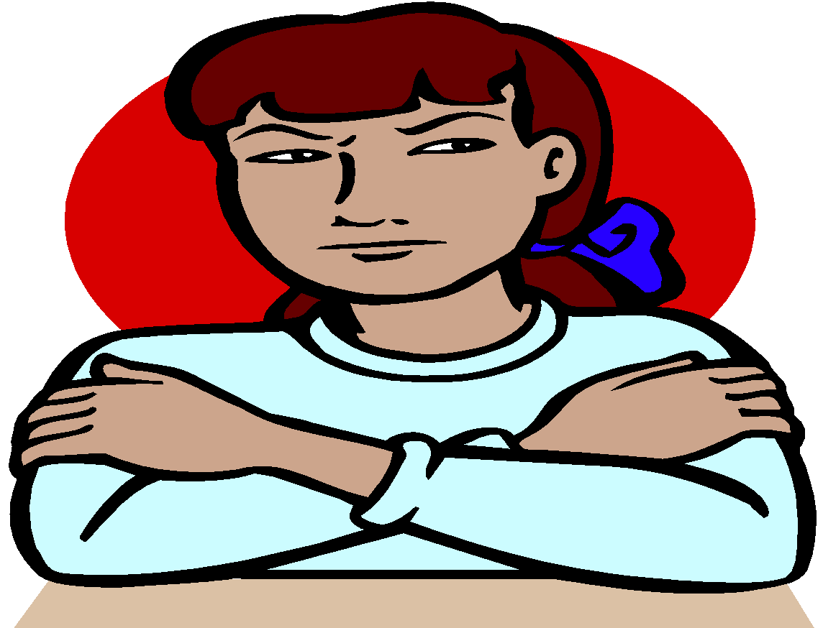
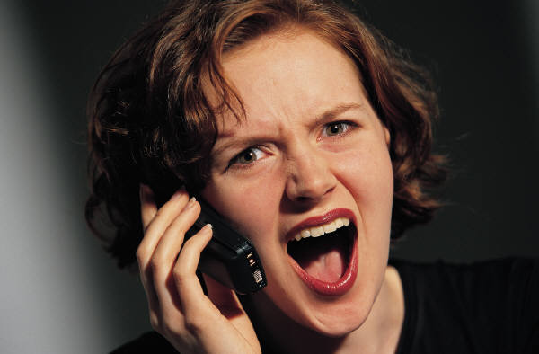
People can have a hard time listening to me when I whine and scream.

Slide 12
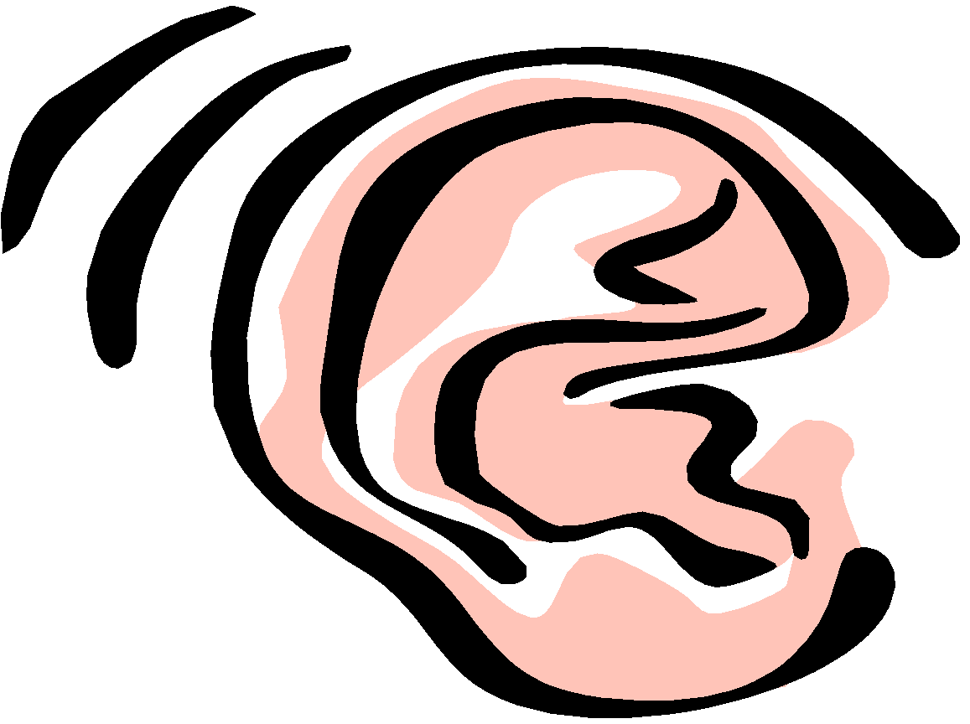
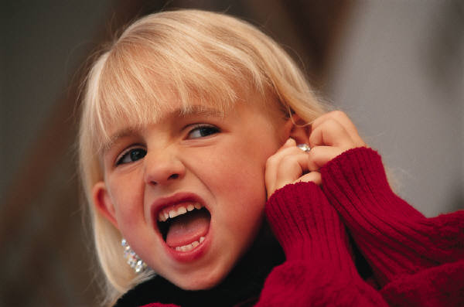
Whining and screaming can hurt people’s ears.

Slide 13
When I whine, scream, or cry,
people around me can get angry or upset.

Slide 14
Everyone is happy when I use my words.

Slide 15

Scripted Story Tip
Please note that you can use real photographs with the line drawings for children that need this level of support. For instance, next to the line drawings, you can glue or Velcro a photograph of two children talking, the teacher talking to a child, a child who is upset, a child who is happy, etc.

